Slide 1

Blockchain for Government
Abdullah Sami
Sikandar Iqbal
Folajimi Oyemomi
Priyanka Bhamare
Nikhil Chhadikar
Sarthak Gautam
Sneha Dinesh Porwal

Slide 2

Introduction
Definition of Blockchain and Trust
Evolution and Adoption of Blockchain
Blockchain's Appeal to Governments
Blockchain Mechanics

Slide 3
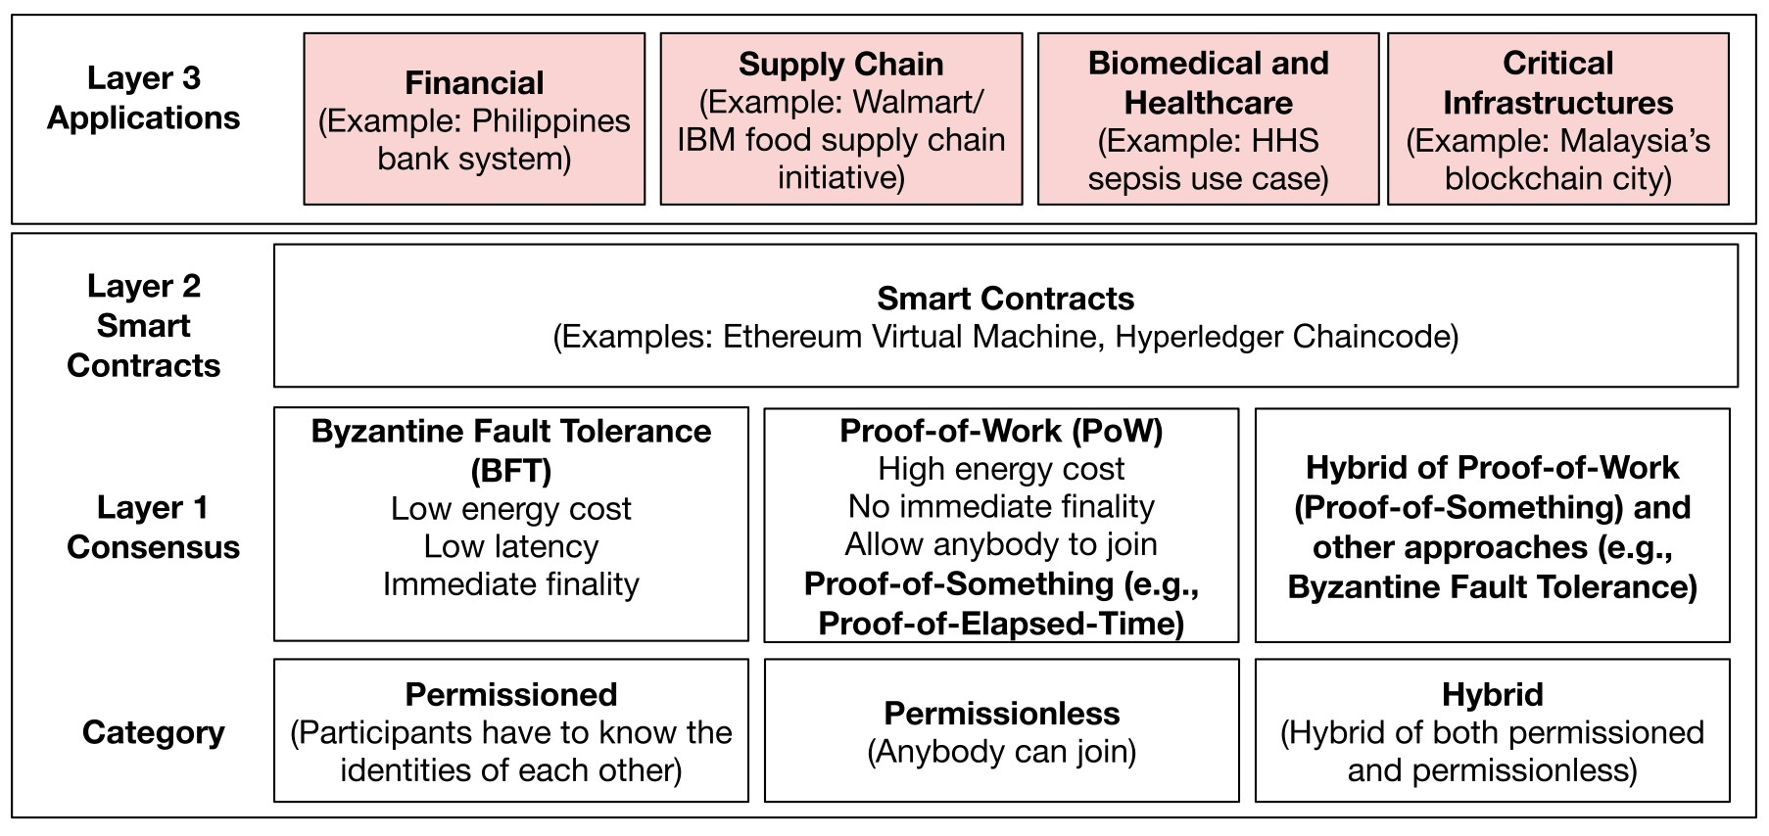
Blockchain: A Layered View

Slide 4
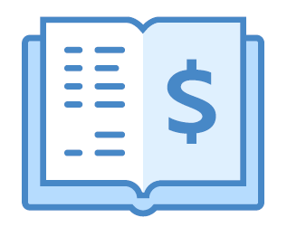
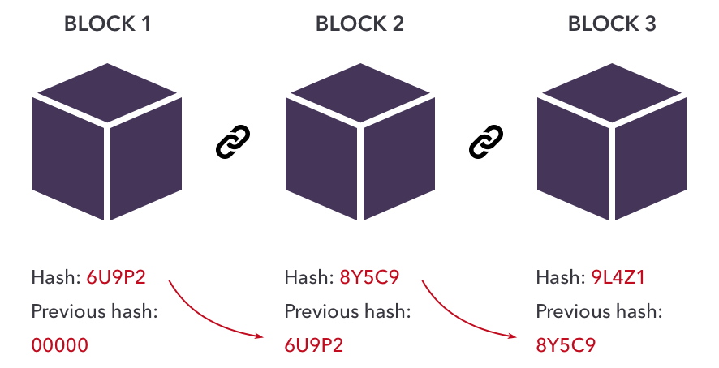


Building the Hash Chain
Cryptographic concepts:
Hashing: tamper-proofing
Digital Signatures: validation
List of transactions
Hashing
Signing

Slide 5
Permissioned Blockchains
PBFT
No expensive consensus protocols like proof-of-work (POW)
Low latency
Scalable
Energy-efficient
Leader: proposes the order of transactions
Nodes: communicate with each other to reach agreement
In each step, matching messages from a fraction of nodes collected
Leader change protocol to deal with faulty leader nodes and elect a new leader

Slide 6
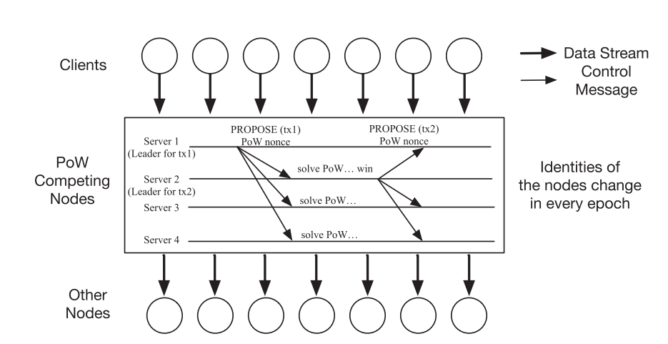

Permissionless Blockchains
Disadvantages of PoW
Message Flow in Proof-of-Work (PoW) Based Blockchains
Limited throughput
High energy consumption
Less decentralized
Less secured

Slide 7
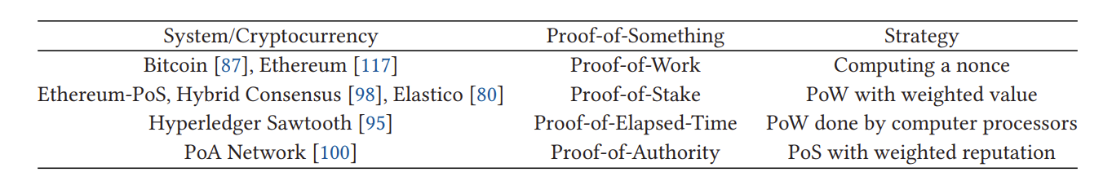
Permissionless Blockchains
Improved System Performance
The need to trust a single user
Permissionless Systems/Cryptocurrency and the Proof They Use to Come to a Consensus

Slide 8

Smart Contracts
Automated programs that execute predefined functions when nodes reach consensus.
Developers – write new smart contracts with functions.
Authorized users – invoke these functions without disrupting other running services.
Use of smart contracts may lead to performance degradation.
Examples:
Ethereum Virtual Machine (using Solidity)
Hyperledger Fabric's Chaincode (written in languages like Go, node.js, and Java).

Slide 9
Blockchain vs Databases
Blockchains | Databases
Prioritize ensuring data security | Focus on managing data
Aim to tolerate Byzantine or arbitrary failures | Handle only crash failures
Strive to achieve linearizability | Provide weaker guarantees like causal consistency

Slide 10
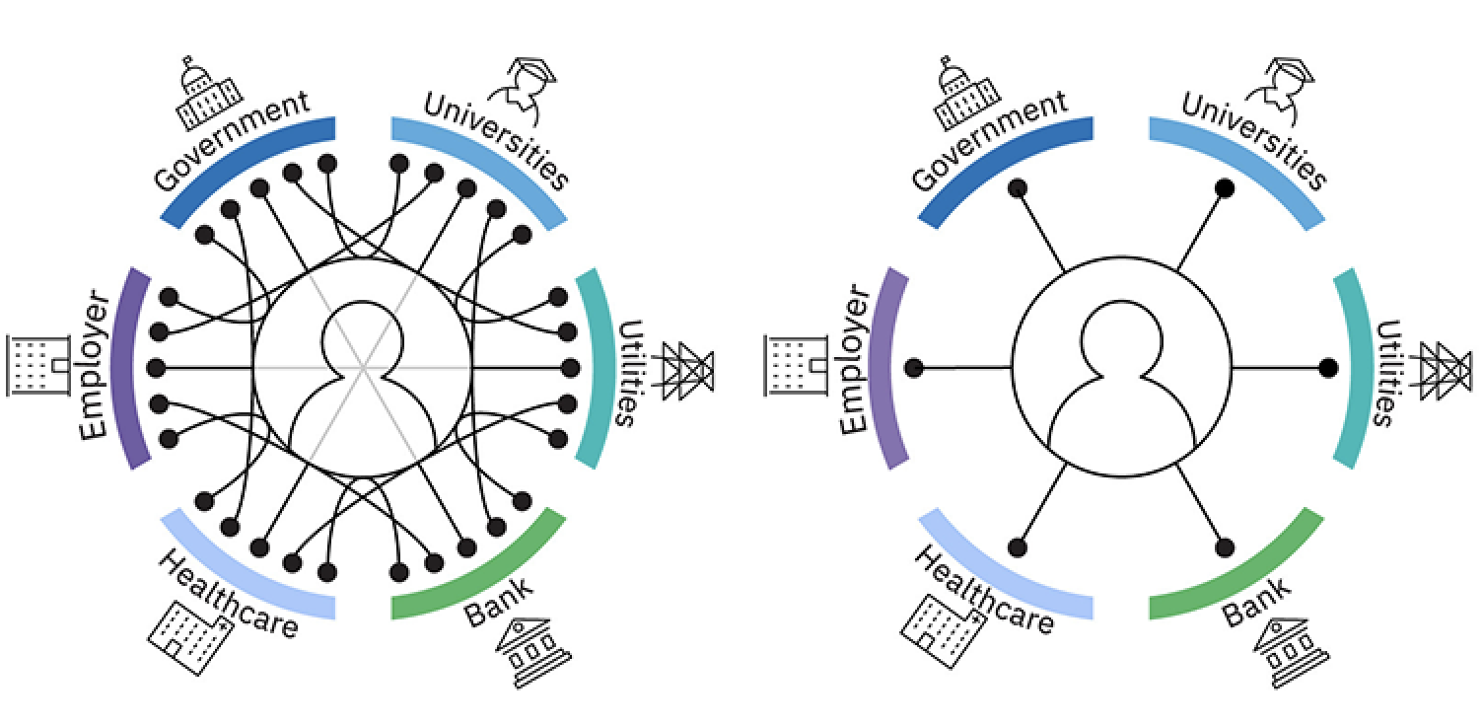
Government Adoption of Blockchain
As interest in blockchain grows globally, governments are exploring its potential across various sectors.

Slide 11

U.S. Government Adoption
The Health and Human Services (HHS) department has pioneered blockchain applications.

Slide 12

Asian Governments’ Adoption
Across Asia, governments are actively adopting blockchain.
In the Philippines, an Ethereum-based solution empowers rural banks.
The Malaysia's blockchain city project and South Korea's investment in a blockchain-enabled power plant showcase regional innovation.

Slide 13
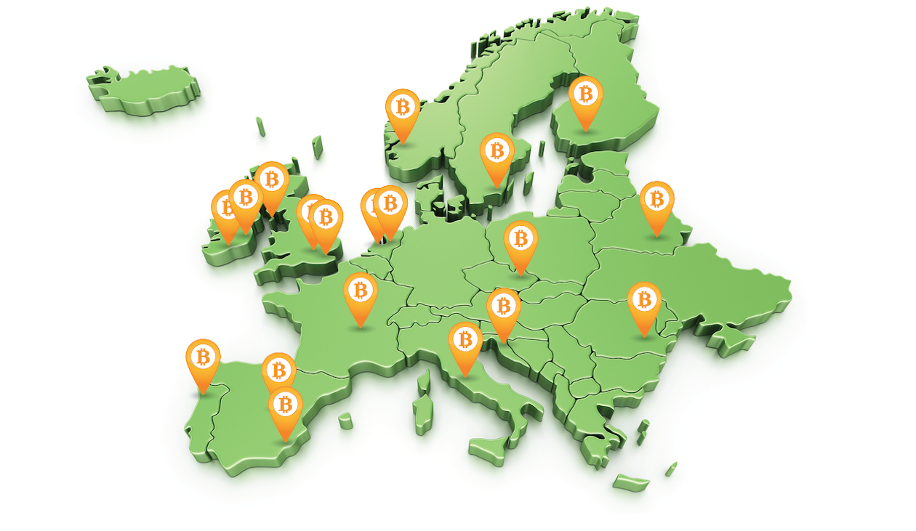
European Governments' Adoption
In Europe, the Horizon program supports blockchain projects.
Luxembourg is pioneering a blockchain governance framework, and Estonia's e-governance program sets the standard.

Slide 14

Blockchain Beyond Borders
Georgia and Sweden leverage blockchain for efficient land title registry and real estate transactions.
In education, Malta recently completed a successful blockchain pilot for managing academic credentials.

Slide 15


Use Case Studies
Critical Infrastructure (Energy)
Government Healthcare

Slide 16
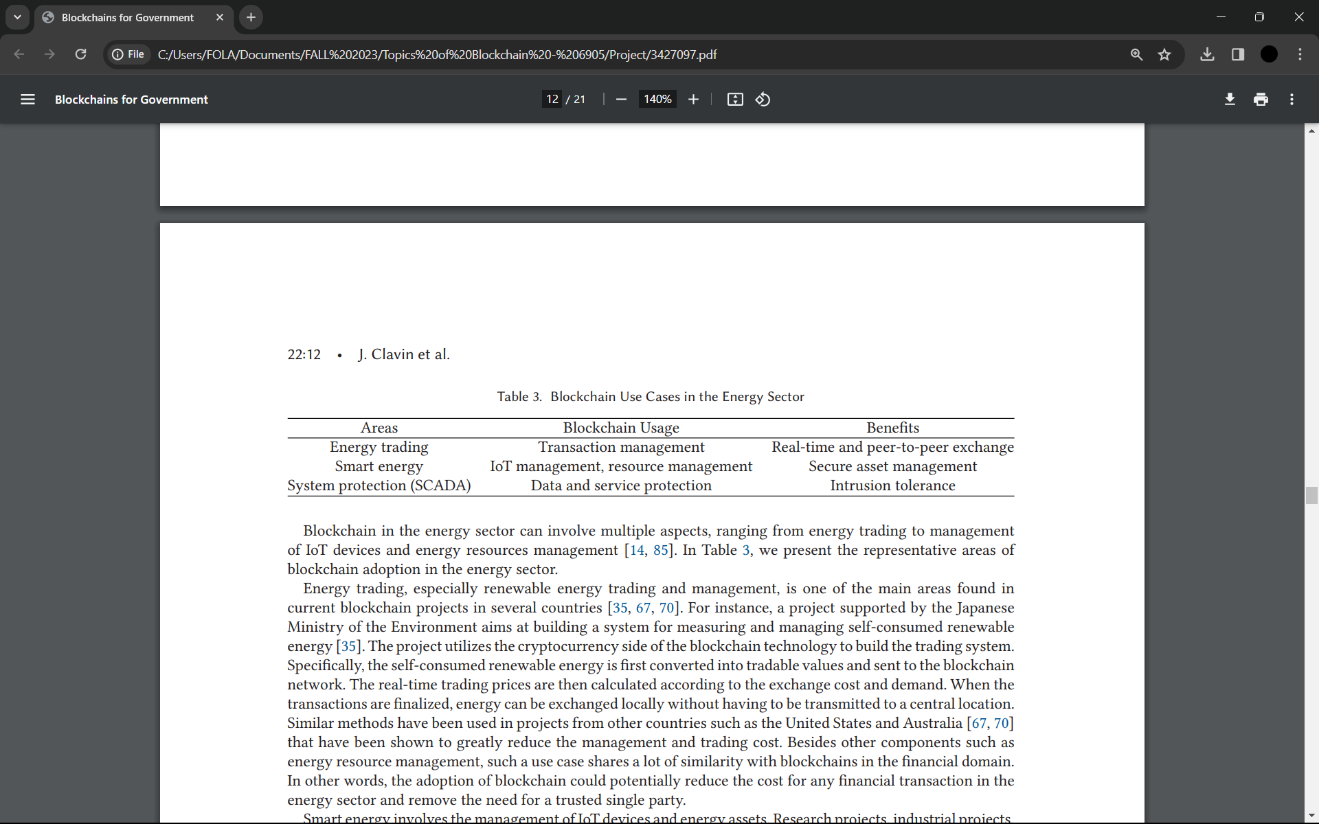
Blockchain in Government Energy Sector
Energy Trading
Smart Energy
Renewable Energy Trading and Renewable Energy Management
Management of IoT devices and energy assets

Slide 17

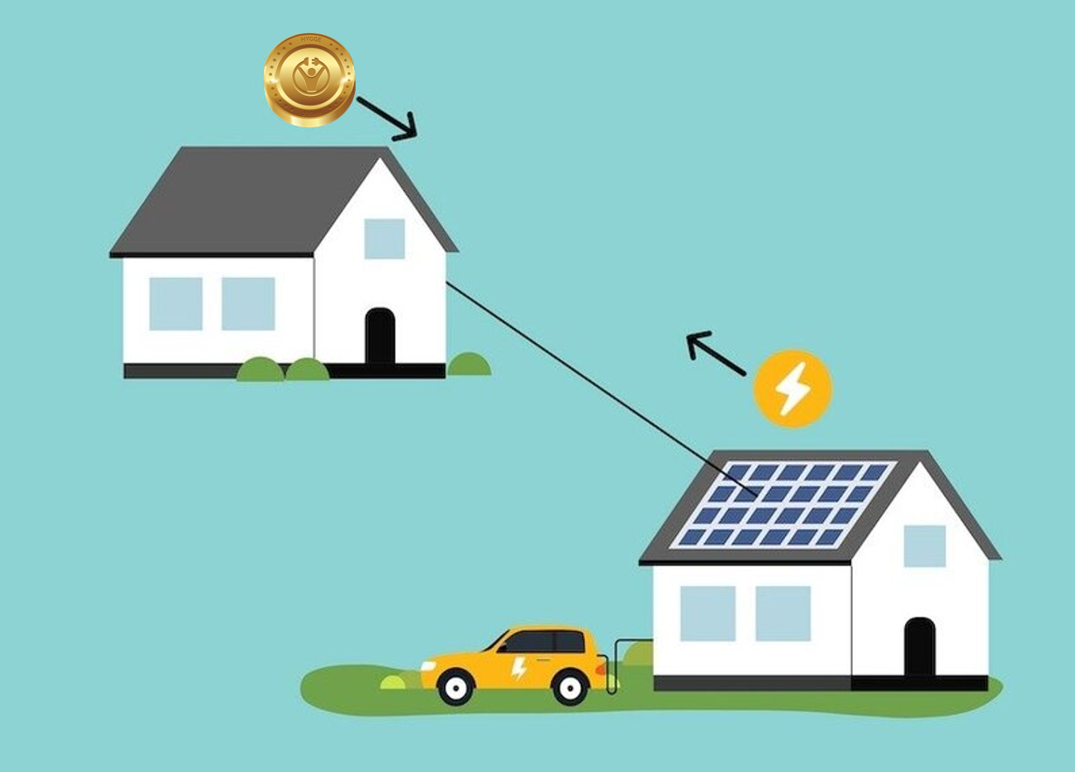
Government Energy Trading
Japanese Ministry of the Environment: Developed a blockchain system for managing self-consumed renewable energy.
United States and Australia: Implemented similar blockchain-based projects.
These initiatives showcased reduced management costs and streamlined energy resource management.

Slide 18


Smart Energy Management
US Department of Energy Initiatives: Funding for university-led and industry-led projects integrating IoT and blockchain technologies into energy infrastructure.
These projects aim to create robust and scalable energy infrastructure by merging IoT devices with blockchain.
Integration offers enhanced security and efficiency in resource management.
Potential disruptions in energy sectors like energy sharing and electric vehicle charging.

Slide 19
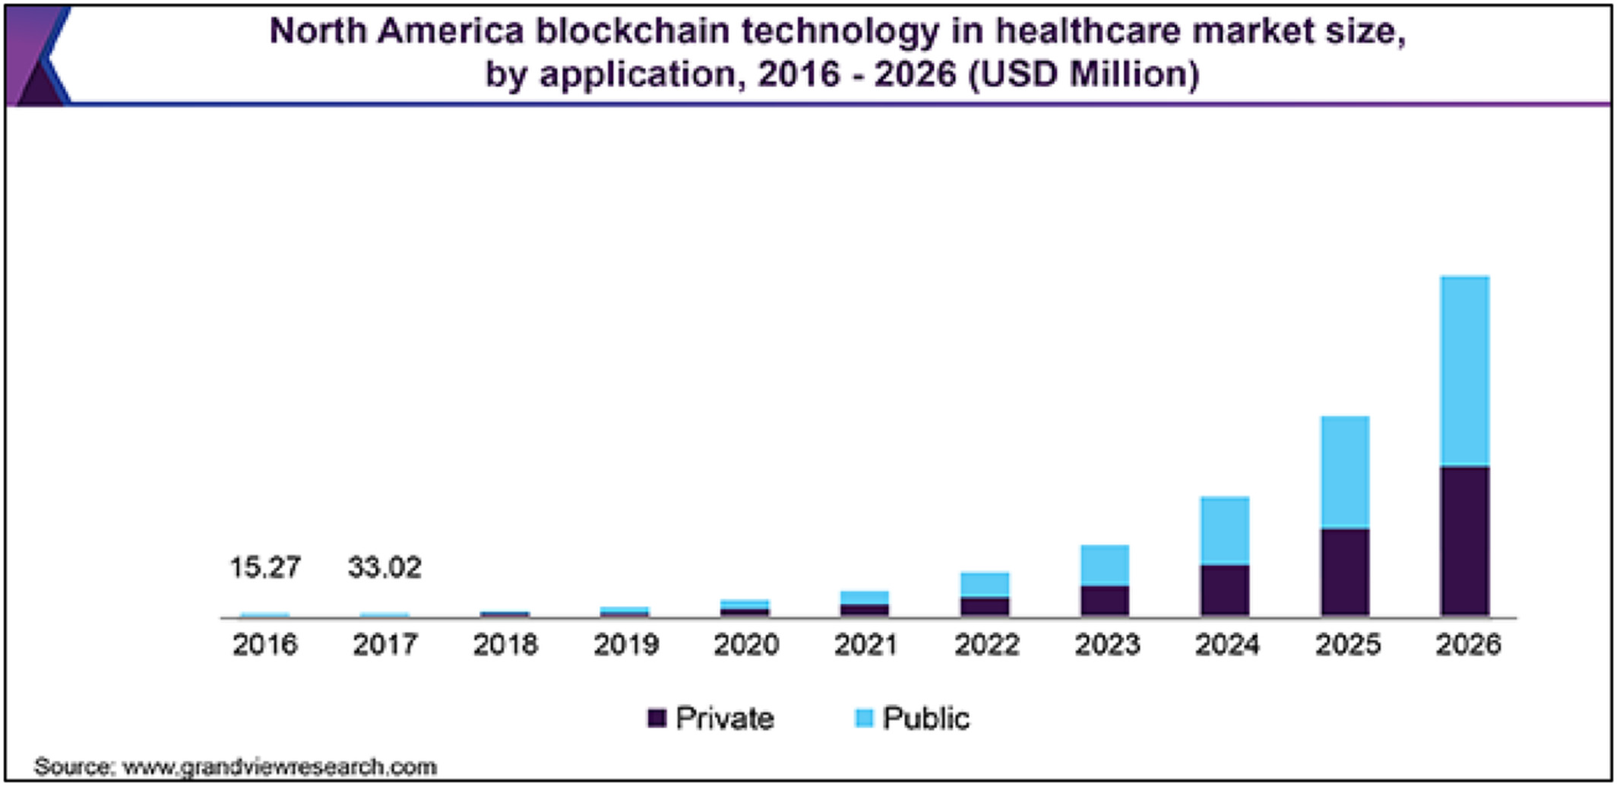
Blockchain in Government Healthcare Sector
Electronic Health Records (EHRs)
Health Information Exchange
Characteristics: Governance, Interoperability, Privacy, Scalability, and Security.
Blockchain as a health information exchange for protected health information.

Slide 20


Blockchain in Electronic Health Records (EHRs)
Technical solutions proposed for privacy and security: Ethereum and Onion Router for remote health monitoring, Enigma blockchain for EHR data exchange.
Proposed use of blockchain in the US for health information exchange: Theoretical blockchain-based technology as a record locator service under the 21st Cures Act

Slide 21

Key Considerations in Blockchain Adoption
Understanding technology and data governance
Standardization and hands-on experience
ISO Committee 307 standards
Interoperability in asset exchange
Public-private innovation and regulatory flexibility
Decentralization costs vs. efficiency
Data quality and security scrutiny

Slide 22
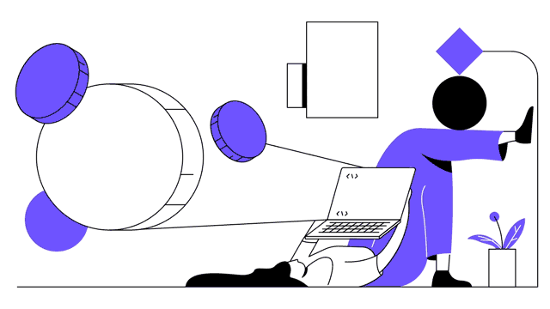
Technical Challenges in Blockchain Adoption
No universal blockchain solution
Expertise in secure system development
Scalability and performance balance
Privacy vs. compliance in government use
Timing protocols: Performance and security considerations

Slide 23
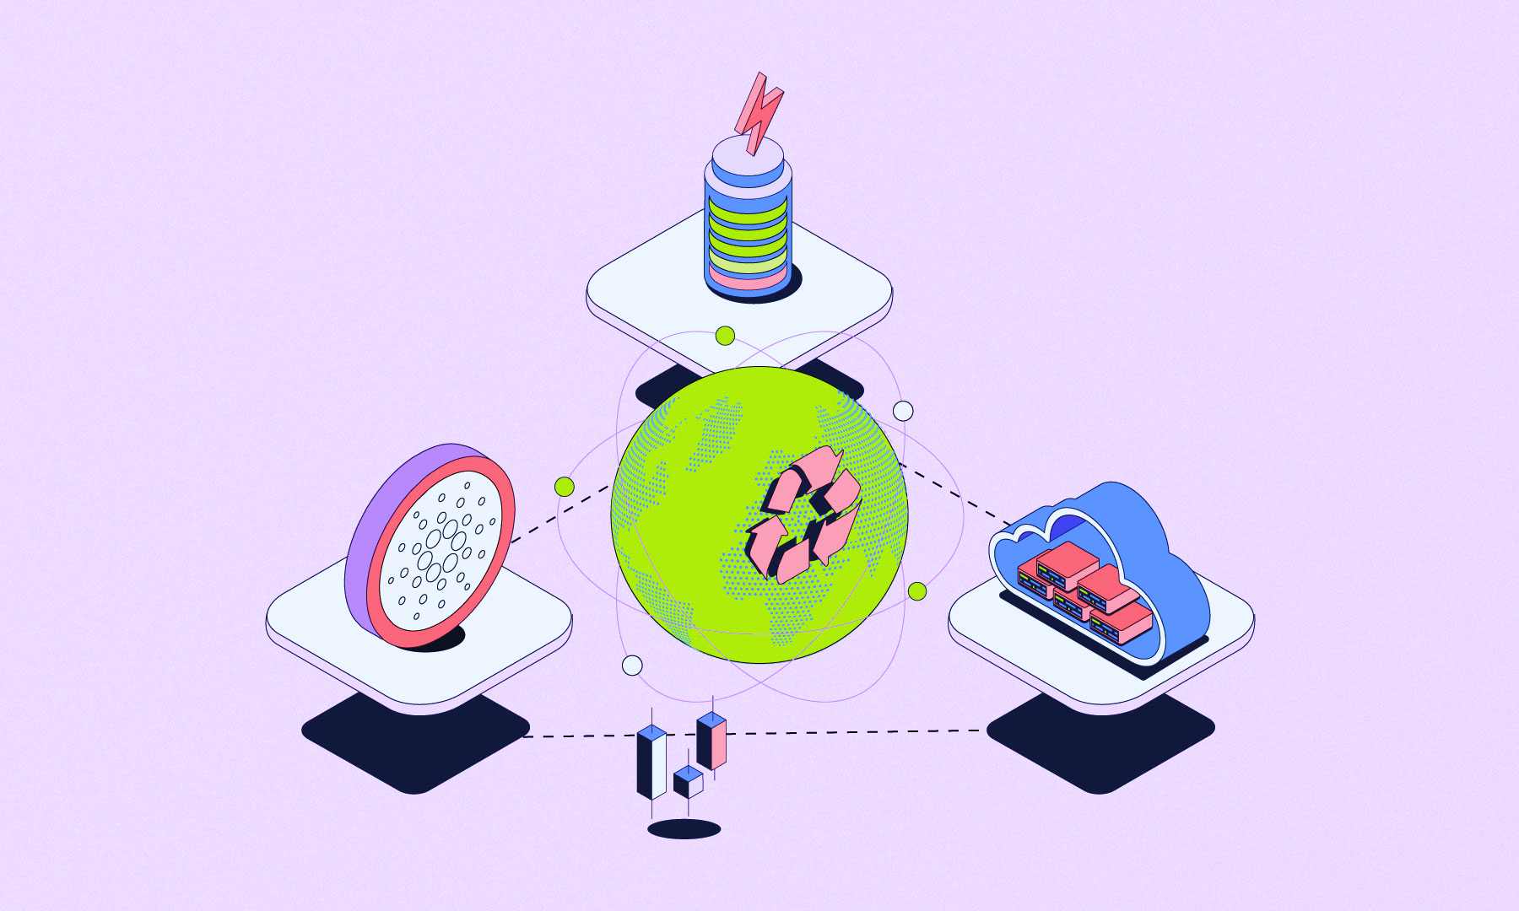
Future of Blockchain
Enhanced Interoperability
Focus on Sustainability and Environmental Impact

Slide 24

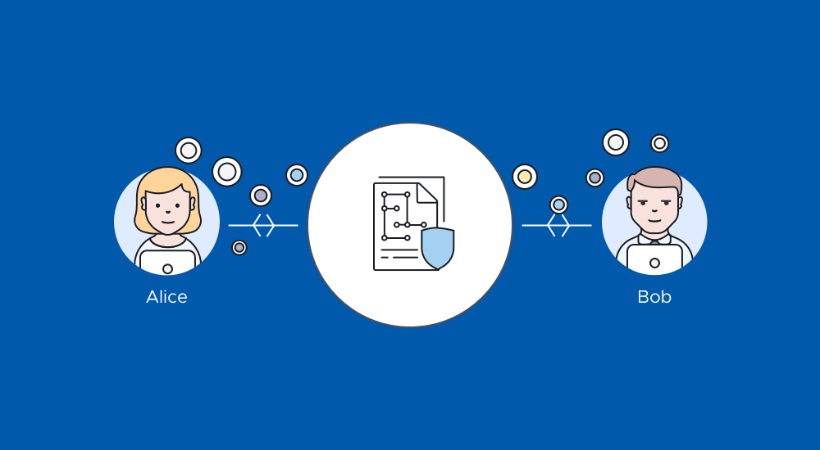
Future of Blockchain
Increased Integration with Traditional Advancements in Scalability Solutions
Evolution of Smart Contracts

Slide 25
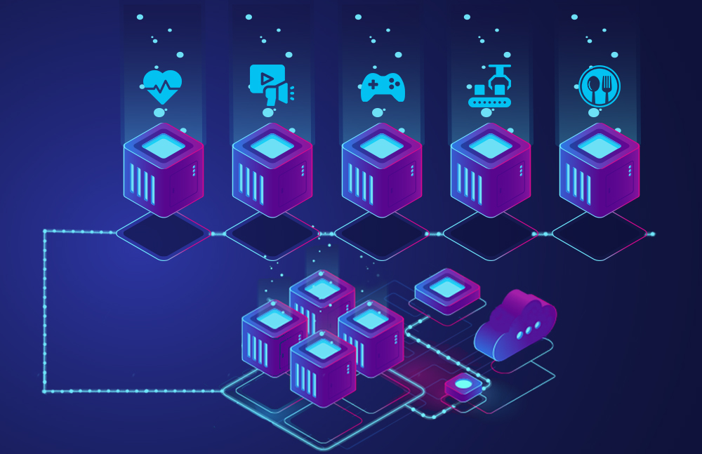
Conclusion
Blockchain is widely in use all around the world by various world governments
We see many governments already adapted and many more amending to these technologies
Blockchains hold promise in improving applications and are poised to address specific distributed systems problems with further development.

Slide 26
Thank You!

